Slide 1
OBSERVER
Daniela Koch (266502)
Dominika Kubicz (266148)
Remedios Pastor Molines (266100)

Slide 2
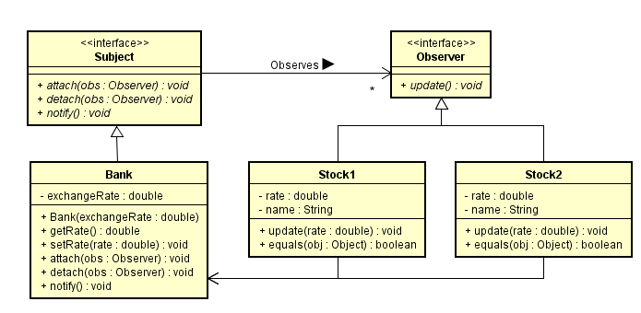
Class Diagram: Activity 1

Slide 3
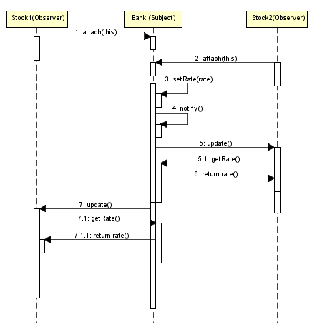
Sequence Diagram: Activity 1

Slide 4
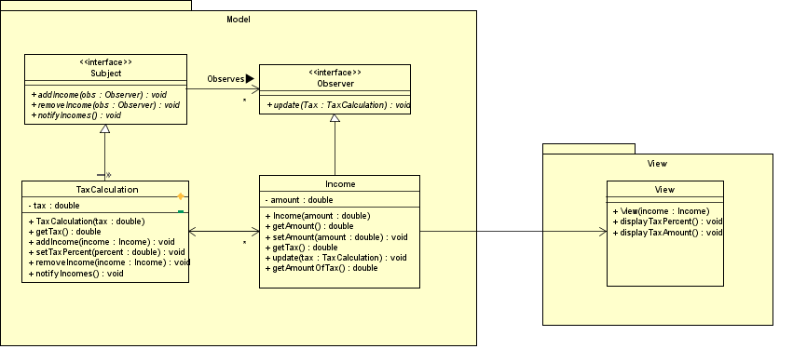
Class Diagrams: Activity 2

Slide 5
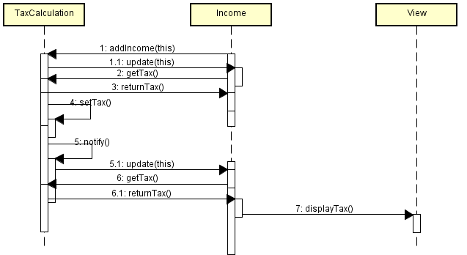
Sequence Diagrams: Activity 2

